Slide 1
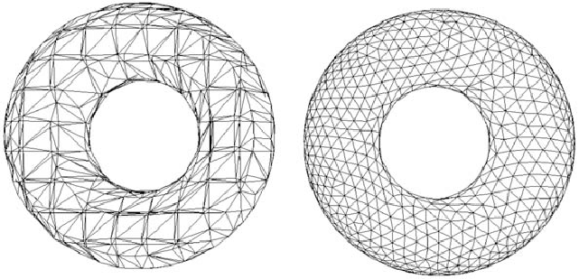
CS6366 Final Project Implement Marching Tetrahedra algorithm
---- Presented by Rong Tu
May 07, 2021

Slide 2
Introduction
Marching tetrahedra is a computer graphics algorithm for extracting a polygonal mesh of an iso-surface from a 3-D volume
Closely related to “Marching Cube” except in that case the fundamental sampling structure is a cube while here it is a tetrahedron
Goal: to implement the marching tetrahedra algorithm, which allows users to select a level of intensity and render the extracted iso-surface.

Slide 3
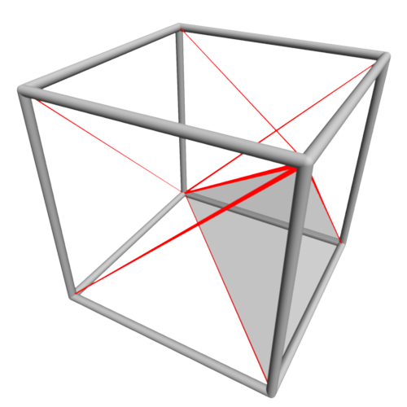
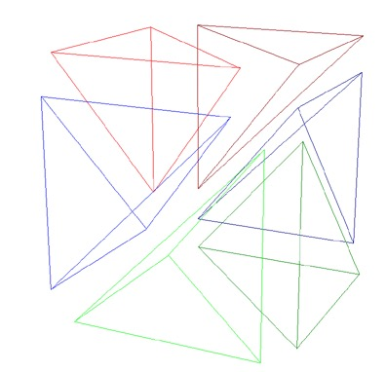
Method
Each cube can be split into six tetrahedra.
The planar facet approximation to the isosurface is calculated for each tetrahedron independently. The facet vertices are determined by linearly interpolating where isosurface cuts the edges of the tetrahedron.

Slide 4
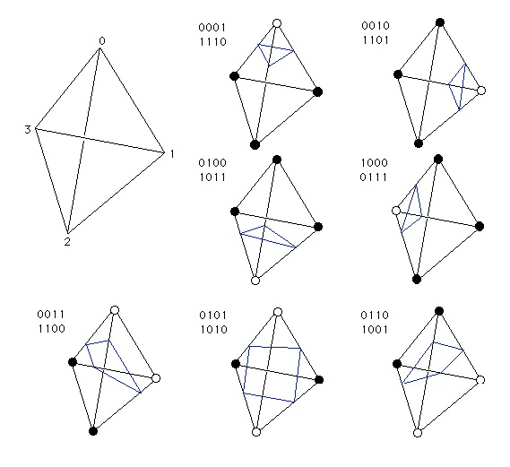
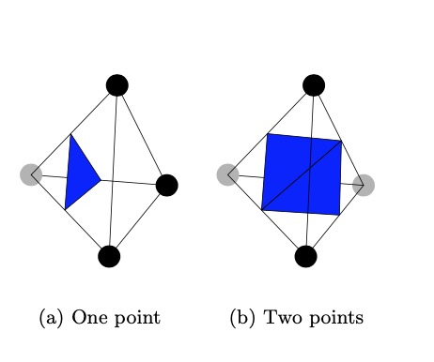
Method
There are 8 different cases:

Slide 5
Visualization
A cool online isosurface algorithm tester

Slide 6
Advantages of marching Tetrahedra
Offers an alternative algorithm that doesn’t require a patent license
It could work on unstructured meshes as well as structured meshes (which could be split into six tetrahedra). In fact, it has been proven that any geometric cell can be deconstructed into a series of tetrahedra, making marching tetrahedra a generic solution for iso-surface extraction on all grid types.
Simpler than marching cube

